Slide 1
Aspects of inequality, Slogan under Human Rights Agenda.

Slide 2
Inequality
Inequality is defined as the unequal distribution of goods and burdens based on one's social class and economic mobility. A good is an element of life that provides value, such as:
Education
Home ownership
Health insurance
Employment
A burden is an element of life that provides hardship.
Some types of inequality include:
Employment income disparities
Home loans
Educational Access
Inequality refers to the phenomenon of unequal and/or unjust distribution of resources and opportunities among members of a given society.

Slide 3
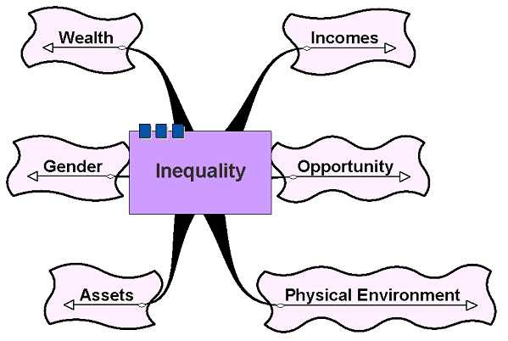
Aspects of Inequality

Slide 4
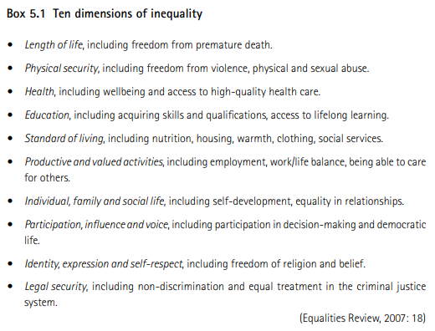

Slide 5
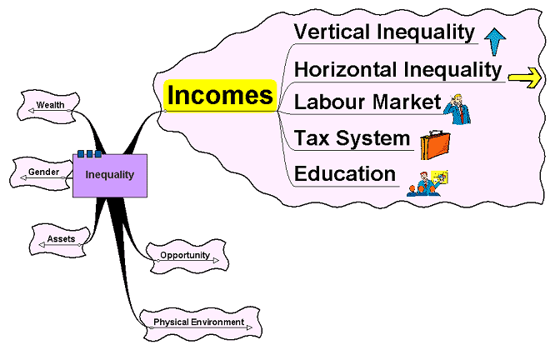
Incomes

Slide 6
Inequality: Incomes
Vertical Inequality
Difference between the rich and the poor
Horizontal Inequality
Where people of similar background, status, qualifications, etc. have differences in incomes

Slide 7
Inequality: Incomes
Caused by:
The Labour Market:
Differences in education, qualifications, skills, abilities and experience mean that the supply of labour differs in relation to the demand
The Tax System:
Impact of taxes that may be regressive in their effect
Ability of some to be able to exploit the system to pay less tax
Education:
Level of education and access to education influences the level of earnings

Slide 8
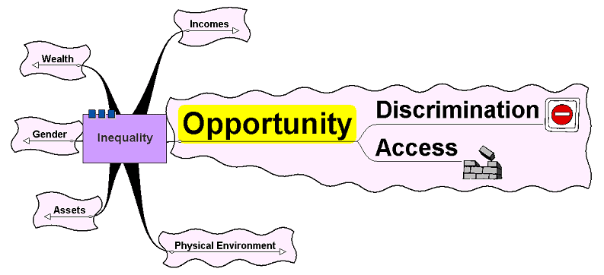
Opportunity

Slide 9
Inequality: Opportunity
The level of opportunity may influence the level of inequality
Access
How easy is it for individuals to access education, work, housing, etc?
How easy is it for countries to access markets?
Discrimination – on the basis of race, ethnicity, gender, etc.

Slide 10
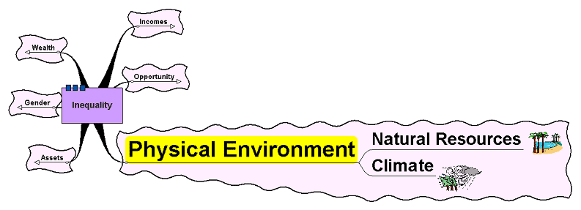
Physical Environment

Slide 11
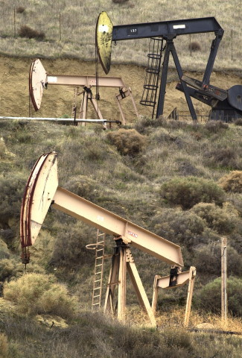
Inequality: Physical Environment
Physical environment can include natural resources, raw materials and climate
Not only availability of natural resources but accessibility and ease with which they can be exploited
It is not enough to have natural resources available, there has to be sufficient capital equipment to be able to exploit them.
Title: California oil is a source of wealth and fear. Copyright: Getty Images, available from Education Image Gallery.

Slide 12
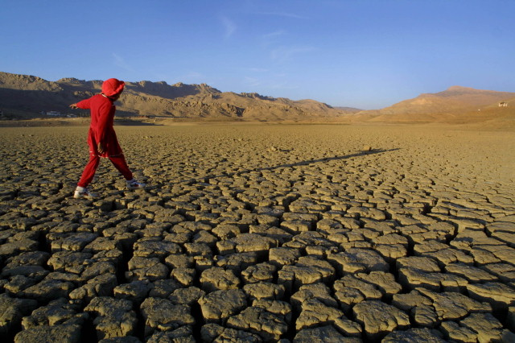
Inequality: Physical Environment
Natural climatic factors are at the heart of a large amount of inequality – it is not coincidence that countries with an equitable climate are the most economically developed
Natural climate and climate change tend to affect those countries least able to help themselves
Extremes of weather tend to impact most heavily on countries who have the lowest ability to cope with such extremes.
Title: Three year drought dries up Pakistan lake. Copyright: Getty Images, available from Education Image Gallery

Slide 13
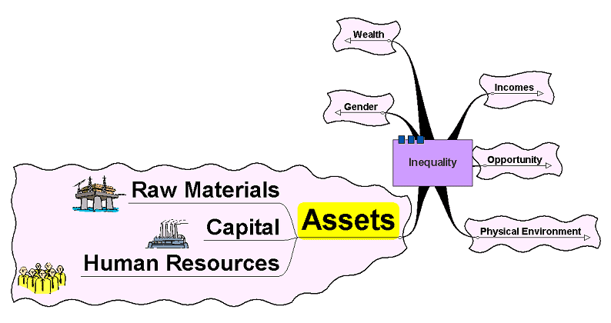
Assets

Slide 14
Inequality: Assets
Not just the quantity but also the quality of assets can impact on inequality
Individuals – ownership of houses, cars, consumer goods, etc.
Countries
Access to raw materials, natural resources, infrastructure – roads, rail telecommunications, etc.
Amount and quality of capital assets
Amount and quality of human assets

Slide 15
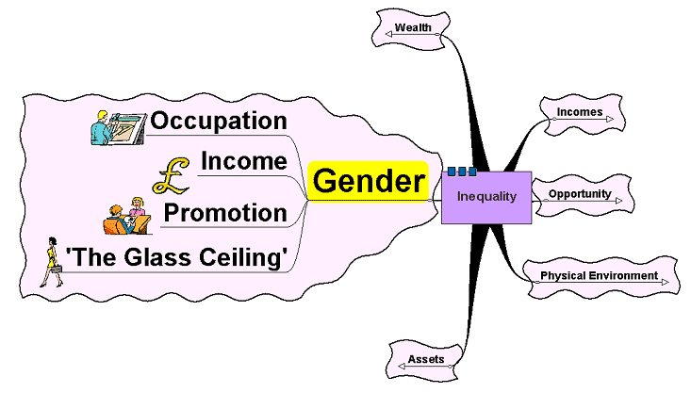
Gender

Slide 16
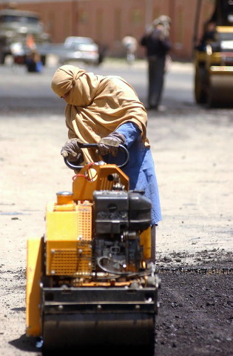
Inequality: Gender
Evidence suggests women still paid less than men for the same job
Some countries actively discriminate against women
Men still dominate positions of power and responsibility
‘Glass ceiling’ – limits the extent to which women can make it to the top
An Afghan woman operates a paving machine on a road that is to be re-surfaced in Kabul, Afghanistan. Women working was outlawed during the rule of the Taliban but have now become more common since the demise of the regime.
Title: An Afghan woman operates heavy machinery. Copyright: Getty Images, available from Education Image Gallery

Slide 17
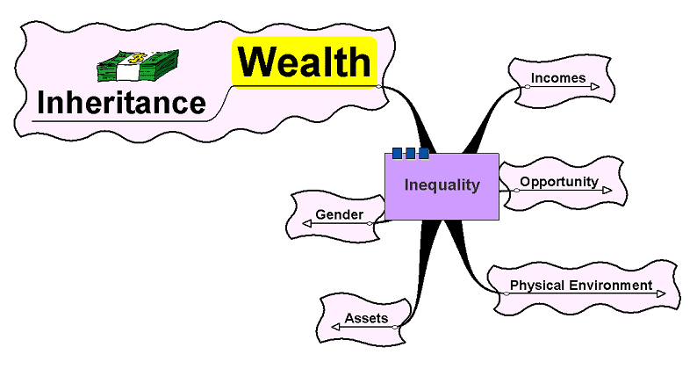
Wealth

Slide 18
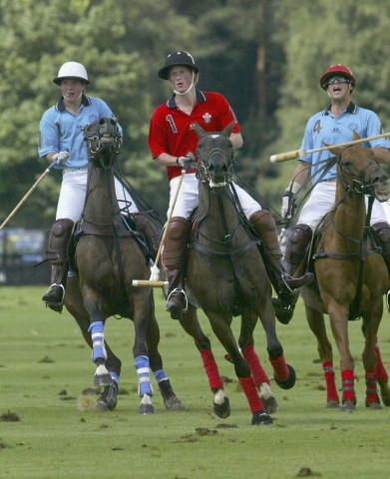
Inequality: Wealth
Differences in wealth – different to that of income
Income = flow
Wealth = stock
Wealth = houses, land, physical assets such as cultural items – artwork, sculptures, etc.
Inherited wealth still a source of inequality
The trappings of inherited wealth still serve as a source to generate inequality.
Title: Cartier Polo. Copyright: Getty Images, available from Education Image Gallery

Slide 19
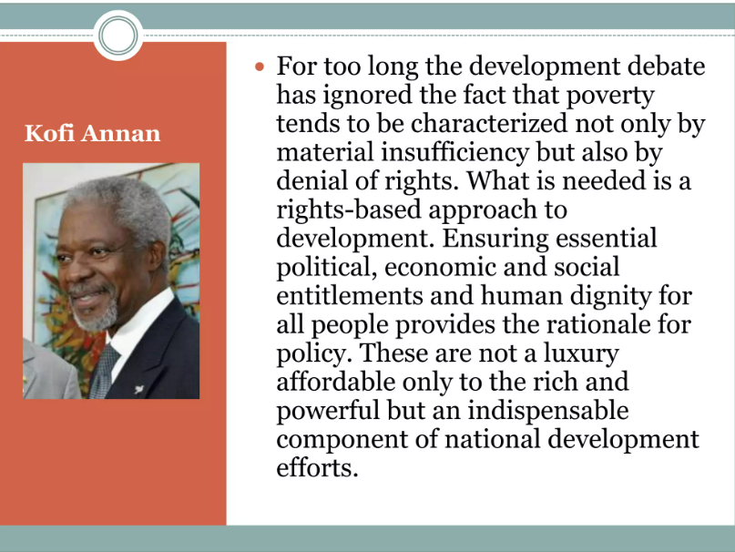
The Slogan under Human Rights Agenda
Fight inequality, Fight Racism

Slide 20
The Slogan under Human Rights Agenda
“The rights of every man are diminished when the rights of one man are threatened.” – John F. Kennedy
“Women’s rights are human rights.” – Hillary Clinton
“We can disagree and still love each other unless your disagreement is rooted in my oppression and denial of my humanity and right to exist.” – James Baldwin
“While poverty persists, there is no true freedom.” – Nelson Mandela
“I have a dream.” – Martin Luther King Jr.

Slide 21
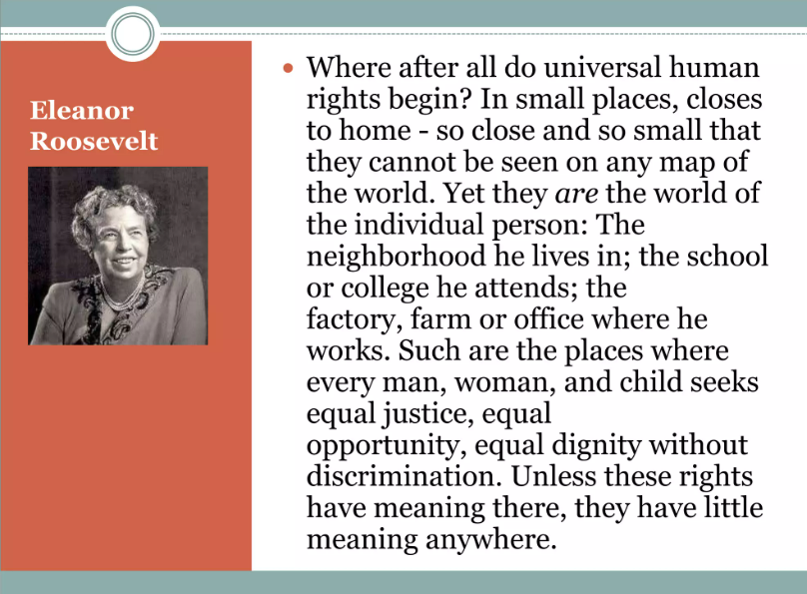
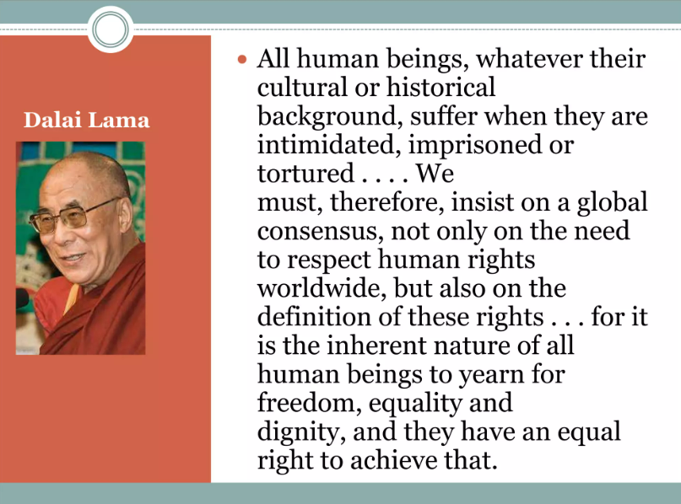

Slide 22
